Slide 1
AUTOMATED ATTENDANCE MANAGEMENT SYSTEM USING FACE RECOGNITION
Mentor
Mr. Ajay Kumar Sahu
Arjun Singh Kushwaha
1614313015
Kumar Kashyap
1614313035

Slide 2
INTRODUCTION
- The main aim of developing this java application
is to provide a complete school or college-based
attendance management system for students .
- The application makes use of face recognition.

Slide 3
Problem Statement
Lots of paper work in traditional system.
- Manual System will manage each and every record
of every student in paper (Time Consuming).
Chances of proxy are more in manual system.
Manual system is not user friendly.

Slide 4
Objectives
To implement a automated attendance system
which will except the image of the person and mark attendance.
User Friendly
Very less paper work
Computer operator control
Report are easily generated

Slide 5
Novelness
- The idea is not new. This project was developed at IIT Kanpur but with availability of large amount of data we can create a more accurate system.
- We present it as an assisitve technology that can be used by schools and colleges .

Slide 6
Limitations
Low Accuracy
Limited due to Webcam
Storage of data

Slide 7
Features
Complete automation is possible in this sector ,which is against the main disadvantage namely time consuming.
Can maintain company faculty details and student details.
Algorithms used are:-PCA(Principal Component Analysis),LDA(Latent Dirichlet Allocation)
,LBPH(Local Binary Pattern Histogram)

Slide 8
Modular Structure
Login Page
Student Entry
Refresh or deleting students image from database
Connection to Database
Data Gatherer
Face Recognition Screen
Attendance Java
Mark Attendance
Function package

Slide 9
Challenges
Choice of servers
Web Cameras
Environmental Conditions such as lighting(proper lighting is required)
Accuracy

Slide 10
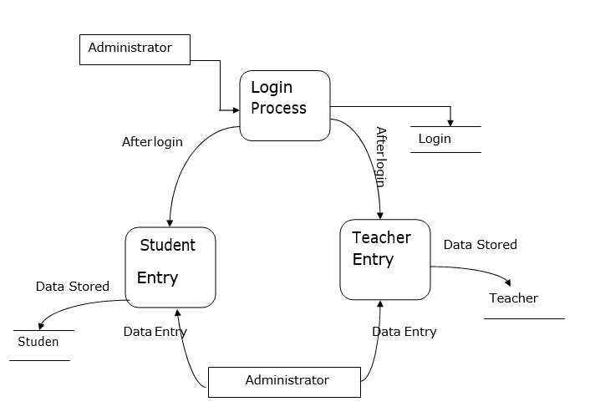
Data Flow Diagram

Slide 11
PCA(Principal Component Analysis) Algorithm
The main idea of principal component analysis (PCA) is to reduce the dimensionality of a data set consisting of many variables correlated with each other, either heavily or lightly, while retaining the variation present in the dataset, up to the maximum extent. The same is done by transforming the variables to a new set of variables, which are known as the principal components (or simply, the PCs) and are orthogonal, ordered such that the retention of variation present in the original variables decreases as we move down in the order.

Slide 12
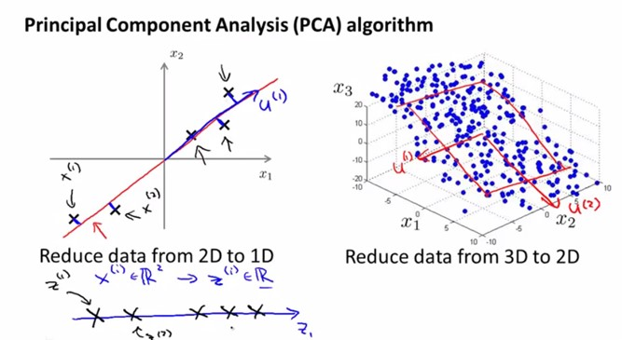
Continued……

Slide 13
LDA(Latent Dirichlet Alogrithm)
In natural language processing, latent Dirichlet allocation (LDA) is a generative statistical model that allows sets of observations to be explained by unobserved groups that explain why some parts of the data are similar. For example, if observations are words collected into documents, it posits that each document is a mixture of a small number of topics and that each word's presence is attributable to one of the document's topics.

Slide 14
LBPH(Local Binary Pattern Histogram) Algorithm
The Local Binary Pattern Histogram(LBPH) algorithm is a simple solution on face recognition problem, which can recognize both front face and side face. However, the recognition rate of LBPH algorithm under the conditions of illumination diversification, expression variation and attitude deflection is decreased. To solve this problem, a modified LBPH algorithm based on pixel neighborhood gray median(MLBPH) is proposed.

Slide 15
Future Work
-We are looking forward to spend some money to get more quality web camera.
-We are looking forward to provide notification via
E-mail.
-We are looking forward to show attendance via
graph.

Slide 16
Conclusion
This system has been proposed for maintaining the attendance record. The main motive behind developing this system is to eliminate all the drawbacks which were associated with manual attendance system.
The drawbacks ranging from wastage of time and paper,till the proxy issues arising in a class, will completely be eliminated.
Hence, desired results with user friendly interface is expected in the future, from the system. The efficiency of the system could also be increased by integrating various steps and techniques in the future developing stages of the system.

Slide 17
References
Akshara Jadhav, Akshay Jadhav, Tushar Ladhe, Krishna Yeolekar, "Automated Attendance System Using Face Recognition", International Research Journal of Engineering and Technology (IRJET), Volume 4, Issue 1, Jan 2017.
Prajakta Lad, Sonali More, Simran Parkhe, Priyanka Nikam, Dipalee Chaudhari, " Student Attendance System Using Iris Detection", IJARIIE-ISSN(O)-2395-4396, Vol-3 Issue-2 2017.
Kisku R. and Rana S. (2016) Multithread Face Recognition in
Cloud. Available at:
https://www.hindawi.com/journals/js/2016/2575904/.Accessed
14 January 2017.

Slide 18
Thank You!

